Slide 1

Commfluence
Deliberate Delineation
Task Designation
Collaborative Creation

Slide 2
Commfluence Team
Jacob Hanson
Erik Hernandez
Conner Hubbel
Shane Loewe

Slide 3
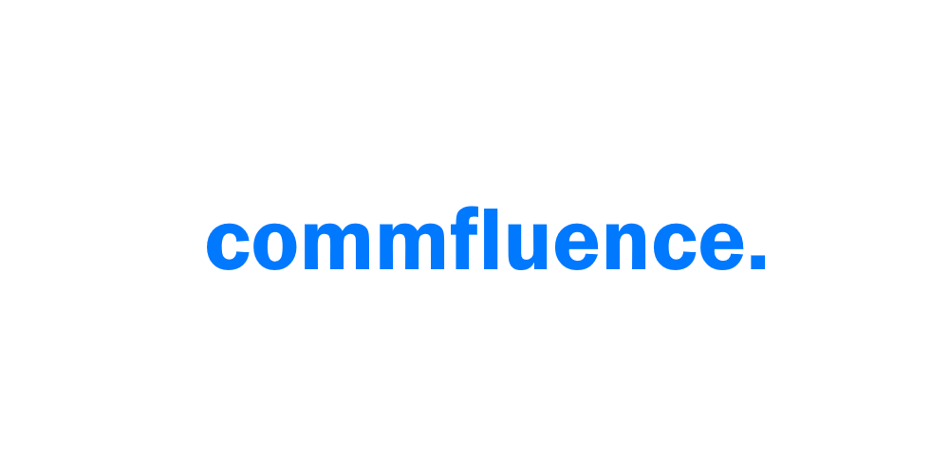
What is Commfluence?
Commfluence is an online collaborative rich-text editor with a built in project and task management system. Perfect for projects with large teams and multiple documents, Commfluence is a web application that is a documentation solution, a project management solution, and a task manager; all in one. Commfluence is a great tool for students and professionals alike.

Slide 4
Development Influences
Originating from a member of the University of Northern Colorado Writing Center, the concept emerged from their experience with the current Writing Center system. They envisioned a dynamic platform for collaborative note-taking and academic document management, empowering users to effortlessly create groups and allocate tasks tailored to specific notes or documents.
From this initial spark, our team embraced a shared vision: to develop an all-encompassing application seamlessly integrated into the existing academic environment. Our teams mission was clear—to deliver a comprehensive solution for academic collaboration and document management.

Slide 5

Sponsor
Dr. Roger Austin
Director of the UNC Writing Center

Slide 6
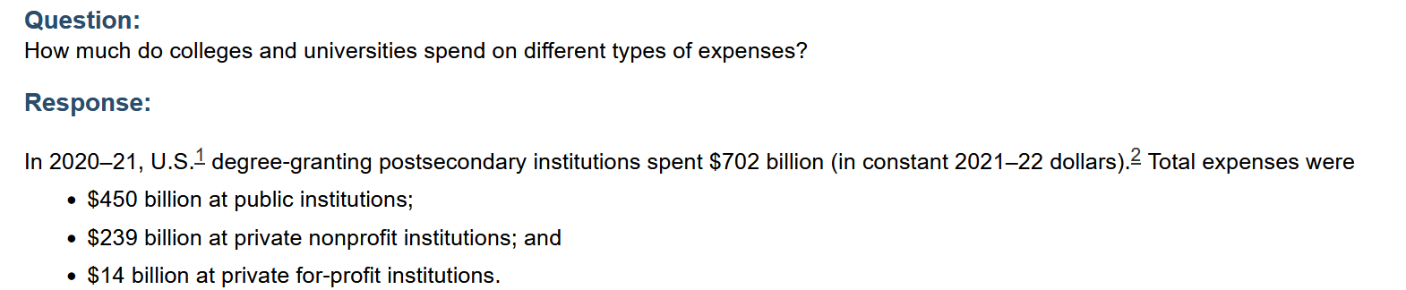
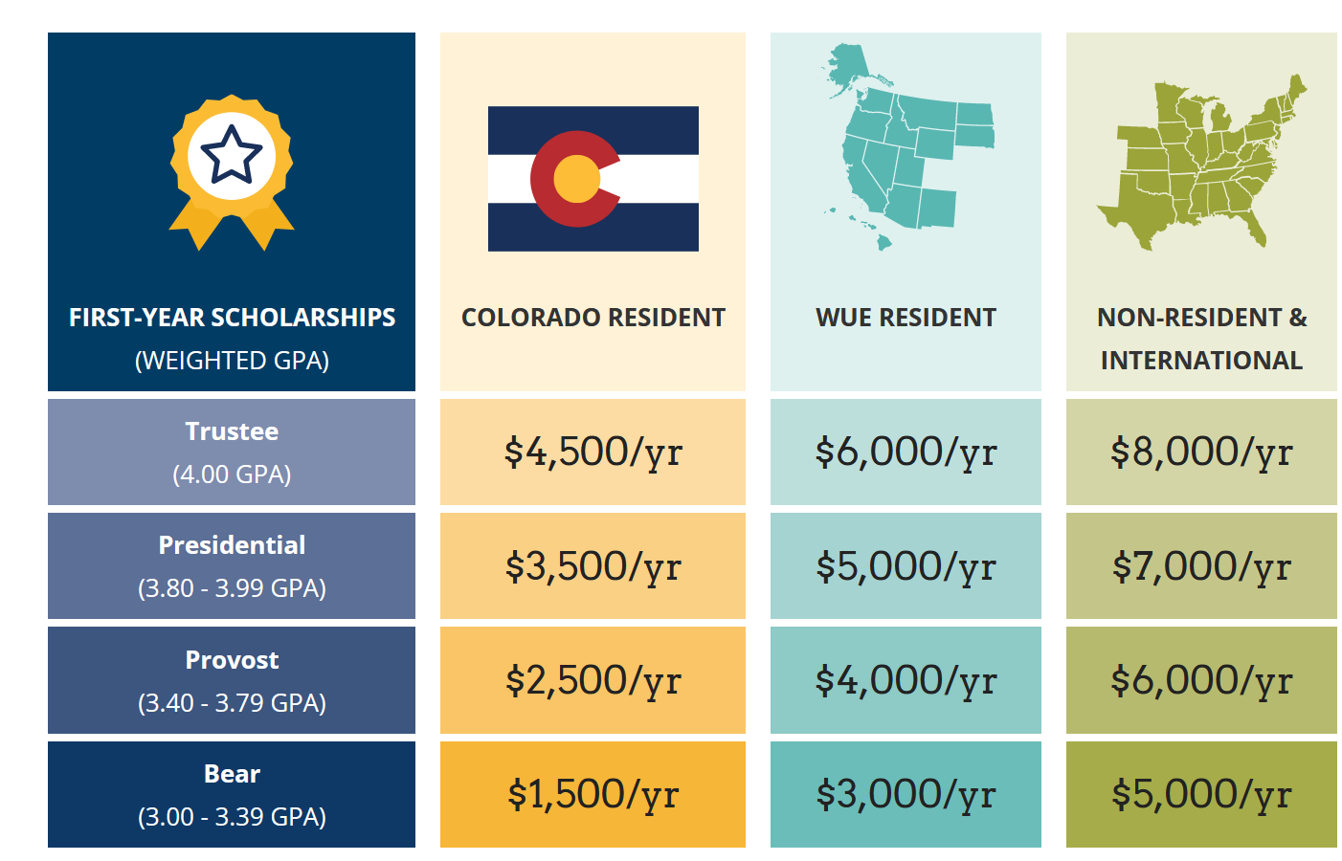
Commfluence Market

Slide 7

Current Application Ecosphere
Obsidian
Non-linear note organization
Bidirectional linking
Not open source
Joplin
Markdown-based note-taking
Cross-platform synchronization
Google Docs
Atlassian Jira

Slide 8

Solutions Commfluence Offers
Document Collaboration:
Commfluence facilitates document and note-taking collaboration, enabling multiple users to create, edit, and review documents and tasks in an easy to use, organized environment.
Knowledge Sharing:
Commfluence serves as a centralized knowledge repository, where users can create, share, and discover valuable academic content. It offers collaborative documentation spaces for storing research findings, best practices, and institutional knowledge.
Drafting and Outlining:
Commfluence employs Quill.js, a simple and easy to use rich-text editor, which gives users full freedom to write to their needs.
Task Designation:
Commfluence was built with tasks in mind, and has a built-in Task Manager for each project, meaning users can divide and conquer with no ambiguity as to who is to do what for what project. This is really what sets us apart from our competitors. Task management apps like Trello and Jira don't have a document editor, and document editors like Docs or Word don't have a task management system.

Slide 9


Building an Academic Collaborative Application
Leveraging React and Firebase
Commfluence Tech Stack:
• React (Front End)
• Firebase/Firestore (Back End)
- Store and Retrieve Data, handling auth, database management, and hosting.
- Serverless architecture, Firebase simplifies backend development
•

Slide 10

Authentication and Security
Firebase Authentication
User authentication and validation managed through multiple authentication files
Firebase handles authorization using email/password credentials.
We achieve
Secure user authentication for only authorized users accessing the application.
Firebase robust authentication system provides our application a reliable method for protecting users data and maintaining privacy.

Slide 11

Development Challenges
Time (16 week dev period)
First time working with technology (learning curve)
Losing a team member, helped with intital design. (workload Demonstration)
Tight budget

Slide 12
Commfluence Demo

Slide 13
The Future of Commfluence
AI implementation
Further scalability
Accessibility functions
Further Academic Templates
Built in writing resources

Slide 14

Thank you. Questions?

